Slide 1

PREDICTING THE MAGNITUDE OF EARTHQUAKES
Presented by :
Mayurakshi Paul . (17030242013)
Sarvagna Mahakali. (17030242012)
Challa LakshmiPrasanna . (17030242004)

Slide 2
Data Set
Significant Earthquakes, 1965-2016
All earthquakes with magnitude of 5.5 or higher
The NEIC- National Earthquake Information Center is a national data center and archive for earthquake information
Disseminates this information immediately to national and international agencies, scientists, critical facilities, and the general public.

Slide 3

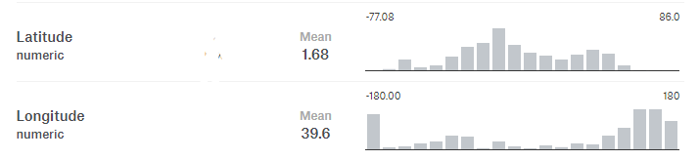


Data Description
23000 observations
0

Slide 4
Problem Statement
To mine space time earthquake patterns from un-observable dynamics using data mining techniques, artificial neural networks and predict the magnitude and occurrence of the earthquakes.
Assumption – All regional factors are filtered out and the general information about the earthquake precursory patterns can be extracted

Slide 5
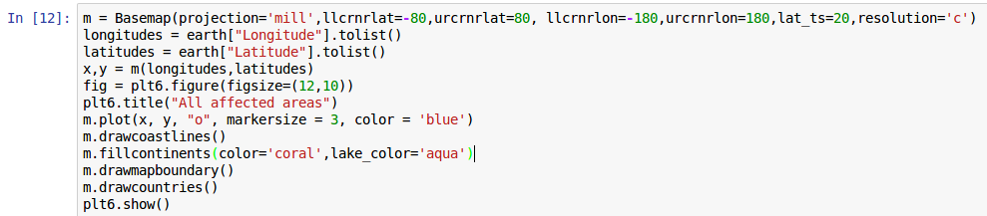
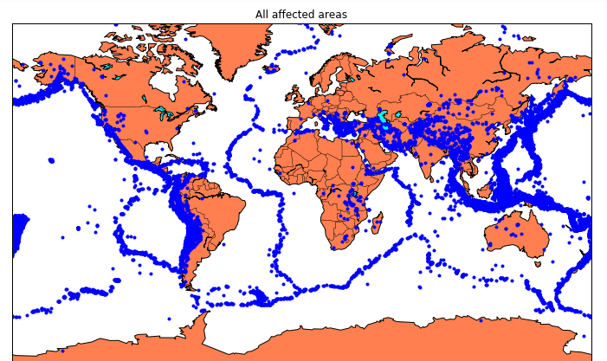
All Areas Effected

Slide 6
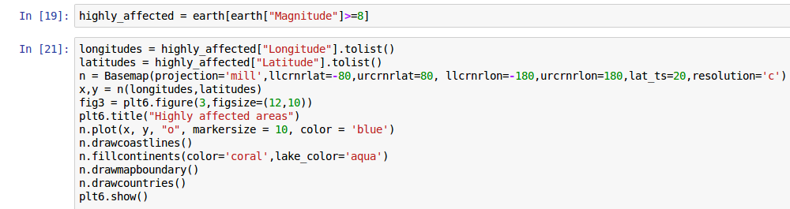
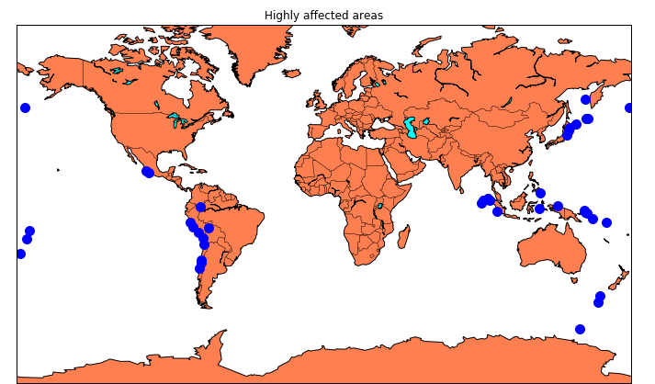
Highly Effected Areas

Slide 7
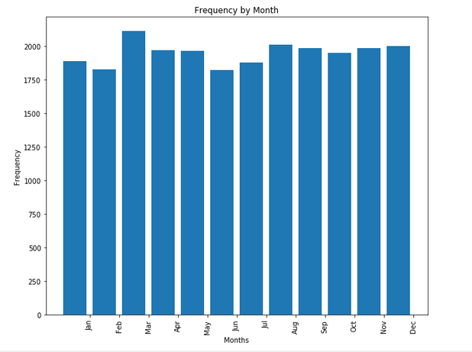
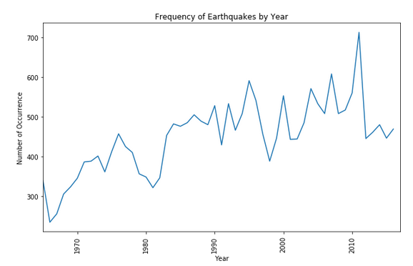
Monthly & Yearly occurrence of Earthquake

Slide 8
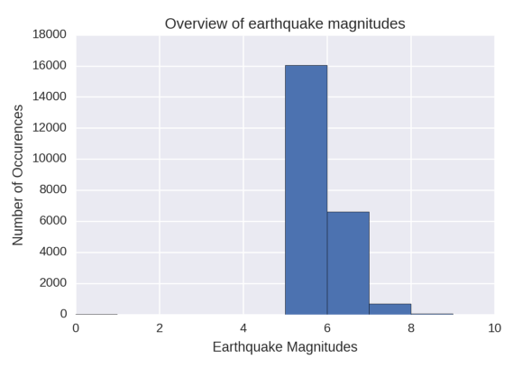
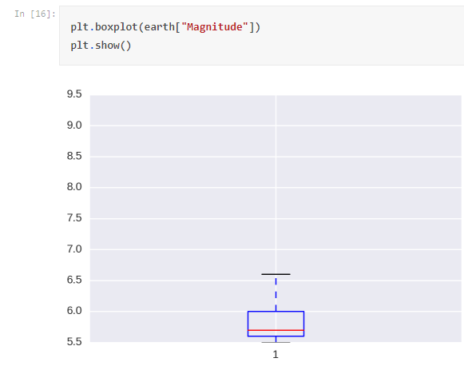
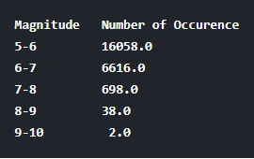
Univariate analysis of Magnitutude
BoxPlot

Slide 9
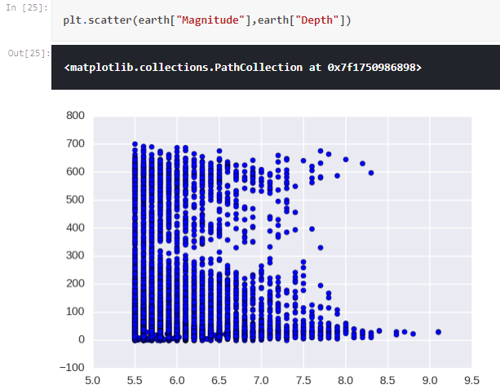
Correlation Between Depth & Magnitude

Slide 10
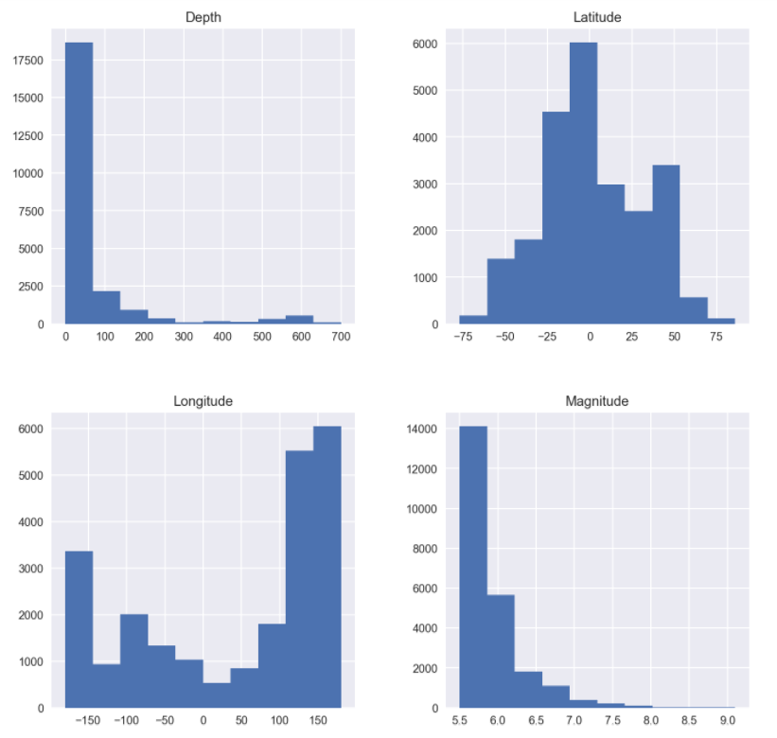
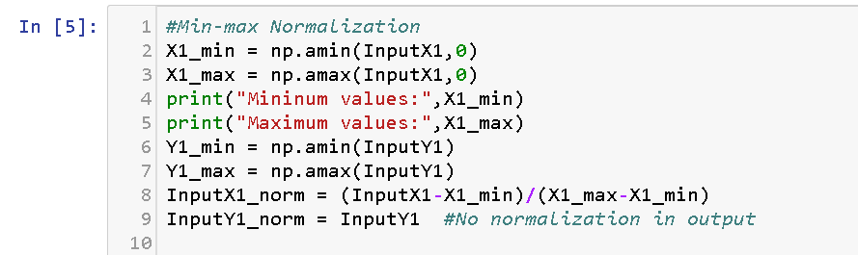
Feature Standardization

Slide 11
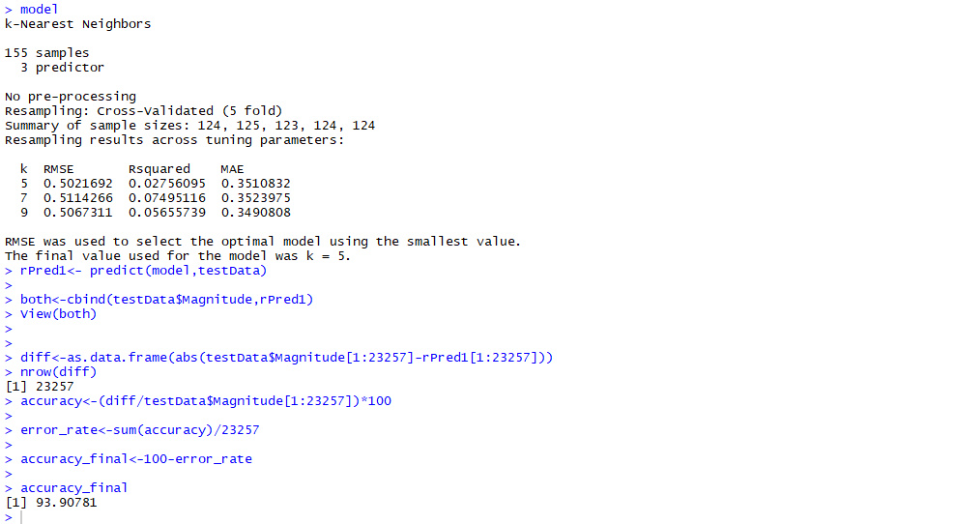
Regression with KNN

Slide 12
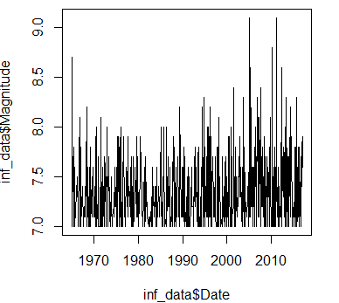
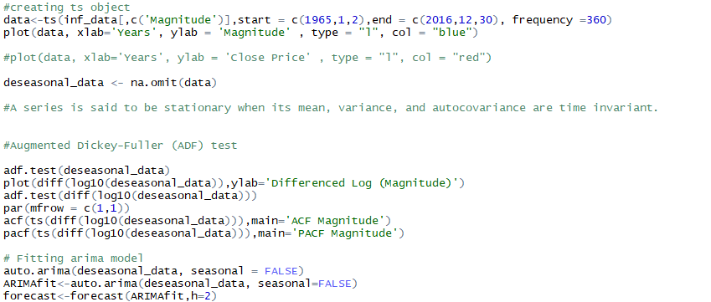
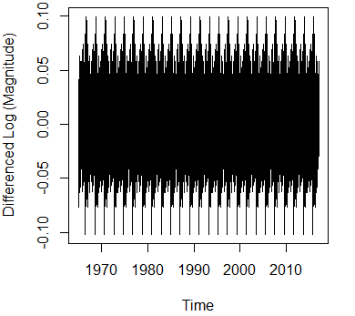
ARMA model
Stationary

Slide 13
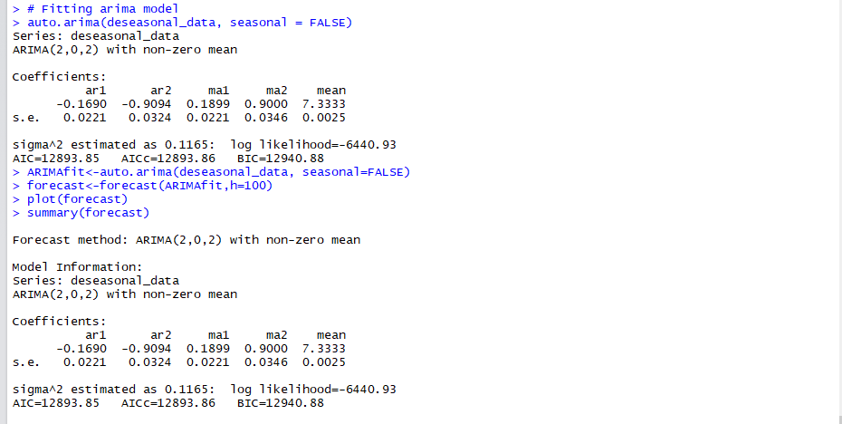
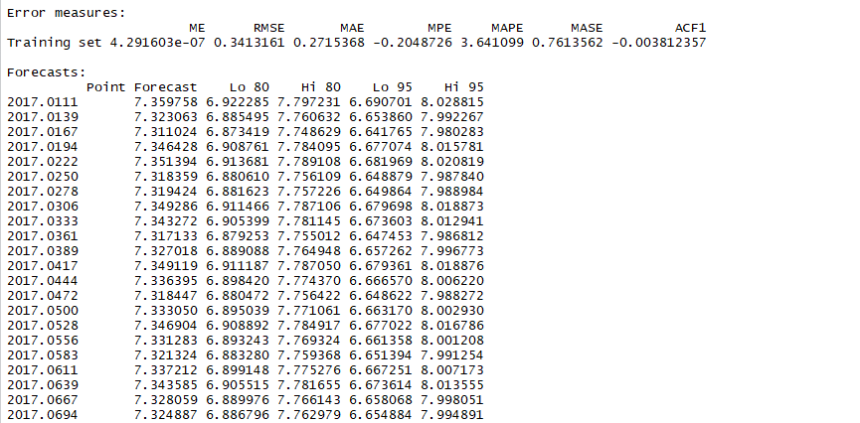
Contd..

Slide 14
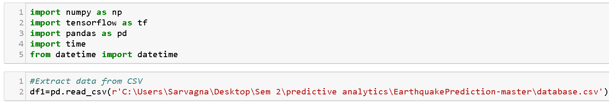
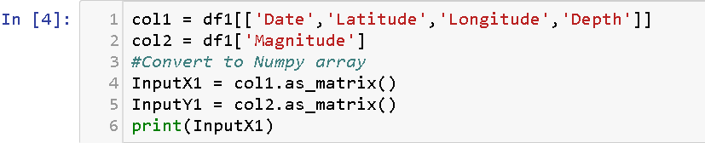
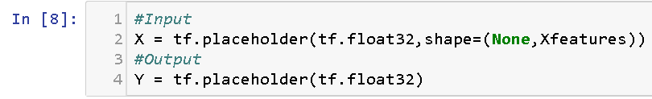
Artificial Neural Network (ANN)
Importing packages and loading the dataset
Selecting relevant features for the model
Creating place holders

Slide 15
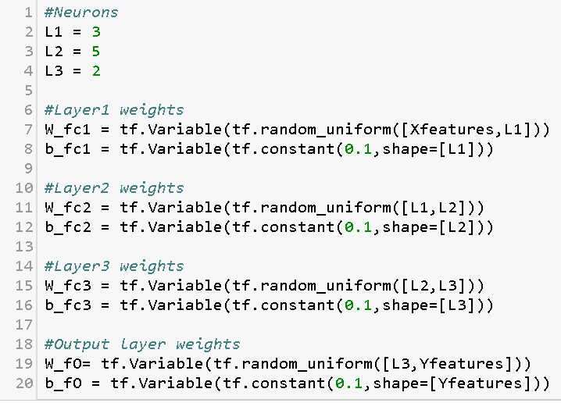
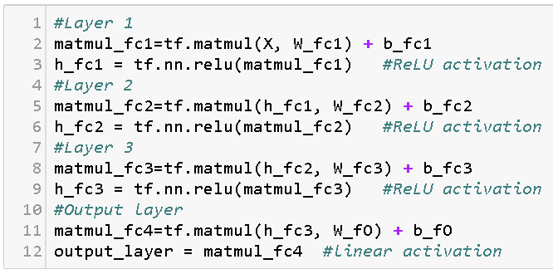
ReLu Activation function

Slide 16
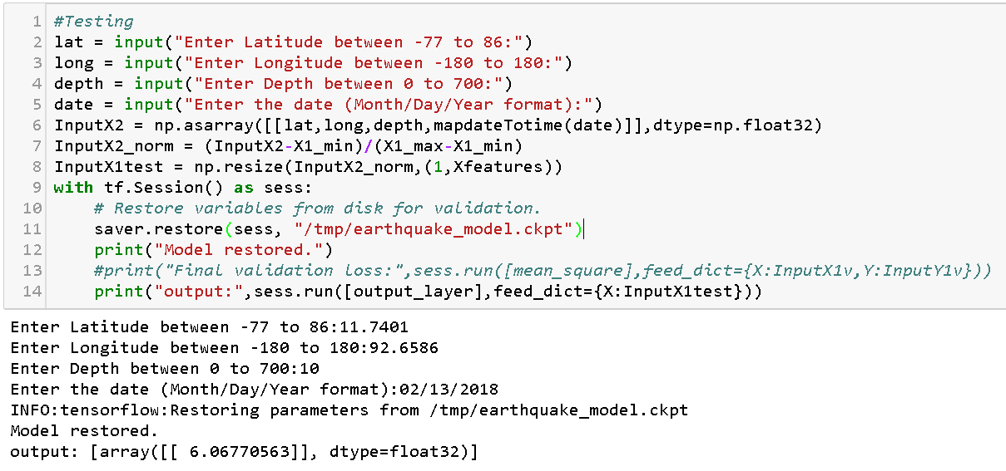
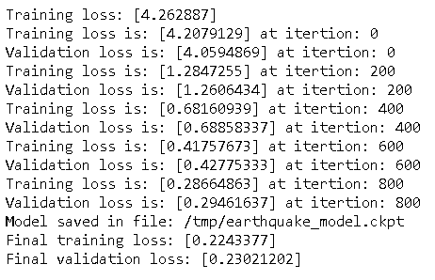
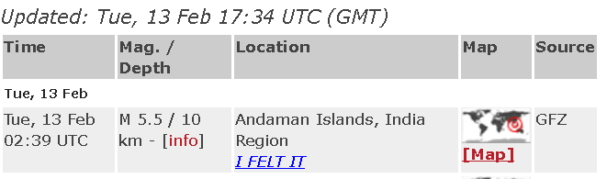
Checking the prediction with the latest earthquake data :
Latest update :

Slide 17
Conclusion
KNN
RMSE
0.5
ARMA
RMSE
0.34
ANN
Loss
Function
0.22

Slide 18
THANK YOU

